Slide 1
Computational Thinking, Problem Solving, and Programming
TOPIC 4.0 – Computational thinking
TOPIC 4
4.2.7 – 4.2.9: Efficiency and Big O Notation

Slide 2

REVIEW REVIEW REVIEW REVIEW REVIEW REVIEW
THE WARM-UP QUESTION
How would we write an algorithm to determine what the most common number in an array is?
No code (at least not yet), just suggestions and ideas (discuss as a class)

Slide 3
REVIEW REVIEW REVIEW REVIEW REVIEW REVIEW
THE WARM-UP ANSWER
Ideally, data is pre-sorted
We keep track of number of instances of a certain number
Variables for maxCount and maxNumber
Keep track of current number and count of that
Variables for currentCount and currentNumber
Replace maxCount and maxNumber if maxCount < currentCount
Print result when all have been checked

Slide 4
TOPIC 4.2.7 – COMPUTATIONAL THINKING
Metrics of an algorithm
Efficiency
Amount of computer resources required to perform the algorithm
Little use of system CPU and Memory
Correctness
Does the algorithm correctly solve the problem every time?
Reliability
Is the algorithm able to sustain itself for a very long time without any errors?
Flexibility
How easy would it be to modify the algorithm for a different or modified purpose?

Slide 5
TOPIC 4.2.8 – COMPUTATIONAL THINKING
Algorithm efficiency
How are we able to deduce what algorithms are more efficient than others?
Open up task manager and watch the CPU, Memory, and Disk use
Task Manager is situational, and not all programs can be easily monitored to tell the difference
Algorithms may be small parts of larger programs
We need a way to tell if an algorithm is efficient just by analyzing it

Slide 6
TOPIC 4.2.8 – COMPUTATIONAL THINKING
BIG o notation
Big O notation allows us to describe how efficient an algorithm is
O(1) means the algorithm isn’t variable in length, no looping elements, etc. The time requirement is constant.
O(logn) means the algorithm has a loop on n elements, but that it only needs to run for log2n elements. The time requirement is logarithmic.
O(n) means that for there is a loop that runs for every element of an array with n elements. The time requirement is linear.
O(n²) means that there are nested for loops running for every element of an array with n elements. The time requirement is quadratic.

Slide 7
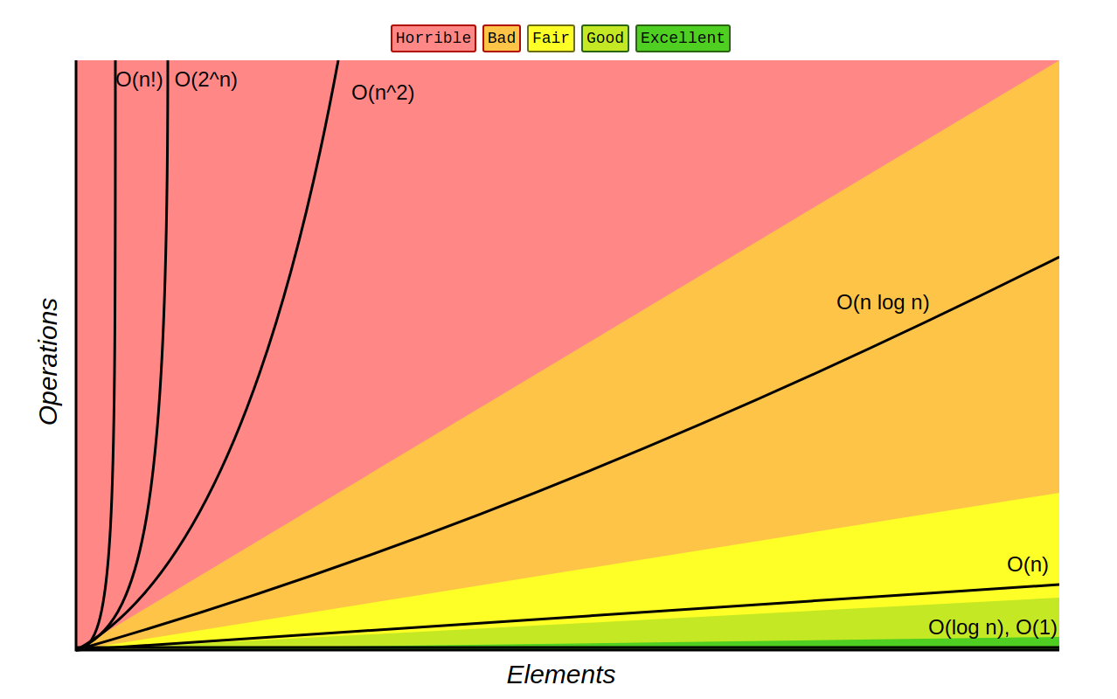
TOPIC 4.2.8 – COMPUTATIONAL THINKING
BIG o notation

Slide 8
TOPIC 4.2.8 – COMPUTATIONAL THINKING
BIG o notation EXAMPLES
O(1): Anything without a loop on an array
O(logn): Binary Search
Cuts n in half every time until, so log2n operations
O(n): Sequential Search
Every n checked, so n operations
O(n²): Selection Sort and Bubble Sort
For every n, check every other n, so n2 operations
If an algorithm loops twice on every n, but they aren’t nested, it’s still only O(n)

Slide 9
TOPIC 4.2.8 – COMPUTATIONAL THINKING
Guess that big o!
Start
If
True
False
Operation 2
Operation 1
End

Slide 10
TOPIC 4.2.8 – COMPUTATIONAL THINKING
Guess that big o!
Start
For
Next
Operation 1
Done
End

Slide 11
TOPIC 4.2.8 – COMPUTATIONAL THINKING
Guess that big o!
Start
For
Next
Operation 1
Done
For
Next
Operation 2
Done
End

Slide 12
TOPIC 4.2.8 – COMPUTATIONAL THINKING
Guess that big o!
Start
For
For
Operation 1
Done
Done
Next
End

Slide 13
TOPIC 4.2.8 – COMPUTATIONAL THINKING
TIME WITH BIG O
Time impact = Constant * Big O
Constant is different based on computer you’re using

Slide 14
TOPIC 4.2.9 – COMPUTATIONAL THINKING
Determine ITERATIONS ACTIVITY
A = input()
B = input()
if A > B then
A = B – 3
loop while A < B
print (“loop 1”)
B = A * 2
loop while B > 7
B = A – 2
print(“loop 3”)
end loop
print(“loop 2”)
end loop
end if
Questions
What’s the output if A = 10 and B = 4?
When A = 4 and B = 10?
When A = 10 and B = 9?
When A = 10 and B = 0?

Slide 15
TOPIC 4.2.8 – COMPUTATIONAL THINKING
BIG o notation EXAMPLES
Algorithms can exist with MUCH worse Big O time
O(2^{n}) – Number of calculations doubles each time n is increased by 1
Exponential Time
Example: Fibonacci Sequence
O(n!) – Man you gotta have a killer bad algorithm to do this one
Factorial Time
Example: Generating all permutations

Slide 16
TOPIC 4.2.8 – COMPUTATIONAL THINKING
BIG o NOTATION
Big O Notation isn’t exactly ‘math accurate’
For example, if an algorithm has two loops, but they aren’t nested, the algorithm is still only O(n), not O(2n).
Any coefficients or constants do not get represented by the algorithm

Slide 17

TOPIC 4.2.9 – THINKING Logically
Vocab to remember
Big O Notation
Constant Time
Linear Time
Logarithmic Time
Quadratic Time
Exponential Time
Factorial Time

